Slide 1
THE LIFE OF CHRIST
PART 10

Slide 2
John 1:35 Again, the next day, John stood with two of his disciples. ³⁶ And looking at Jesus as He walked, he said, "Behold the Lamb of God!"

Slide 3
John 1:37 The two disciples heard him speak, and they followed Jesus. ³⁸ Then Jesus turned, and seeing them following, said to them, "What do you seek?" They said to Him, "Rabbi" (which is to say, when translated, Teacher), "where are You staying?" ³⁹ He said to them, "Come and see." They came and saw where He was staying, and remained with Him that day (now it was about the tenth hour).

Slide 4
John 1:40 One of the two who heard John speak, and followed Him, was Andrew, Simon Peter's brother. ⁴¹ He first found his own brother Simon, and said to him, "We have found the Messiah" (which is translated, the Christ).

Slide 5
The Bible does not teach us much about Andrew, but he was good at bringing people to Jesus.
He brought his brother Peter.
He found the lad who had five barley loaves and two fishes (Jn. 6:8ff).
Andrew and Philip brought some Greeks to Jesus (Jn. 12:22ff).
He found himself within the inner circle of Jesus’ closest disciples at the Mount of Olives (Mk. 13:3).
Tradition teaches that Andrew was crucified in an X position.

Slide 6
John 1:41 He first found his own brother Simon, and said to him, "We have found the Messiah" (which is translated, the Christ). ⁴² And he brought him to Jesus. Now when Jesus looked at him, He said, "You are Simon the son of Jonah. You shall be called Cephas" (which is translated, A Stone).

Slide 7
John 1:43 The following day Jesus wanted to go to Galilee, and He found Philip and said to him, "Follow Me." ⁴⁴ Now Philip was from Bethsaida, the city of Andrew and Peter.

Slide 8
John 1:45 Philip found Nathanael and said to him, "We have found Him of whom Moses in the law, and also the prophets, wrote -- Jesus of Nazareth, the son of Joseph." ⁴⁶ And Nathanael said to him, "Can anything good come out of Nazareth?" Philip said to him, "Come and see."

Slide 9
John 1:47 Jesus saw Nathanael coming toward Him, and said of him, "Behold, an Israelite indeed, in whom is no deceit!" ⁴⁸ Nathanael said to Him, "How do You know me?" Jesus answered and said to him, "Before Philip called you, when you were under the fig tree, I saw you." ⁴⁹ Nathanael answered and said to Him, "Rabbi, You are the Son of God! You are the King of Israel!"

Slide 10
John 1:50 Jesus answered and said to him, "Because I said to you, 'I saw you under the fig tree,' do you believe? You will see greater things than these." ⁵¹ And He said to him, "Most assuredly, I say to you, hereafter you shall see heaven open, and the angels of God ascending and descending upon the Son of Man."

Slide 11
John 2:1 On the third day there was a wedding in Cana of Galilee, and the mother of Jesus was there. ² Now both Jesus and His disciples were invited to the wedding.

Slide 12
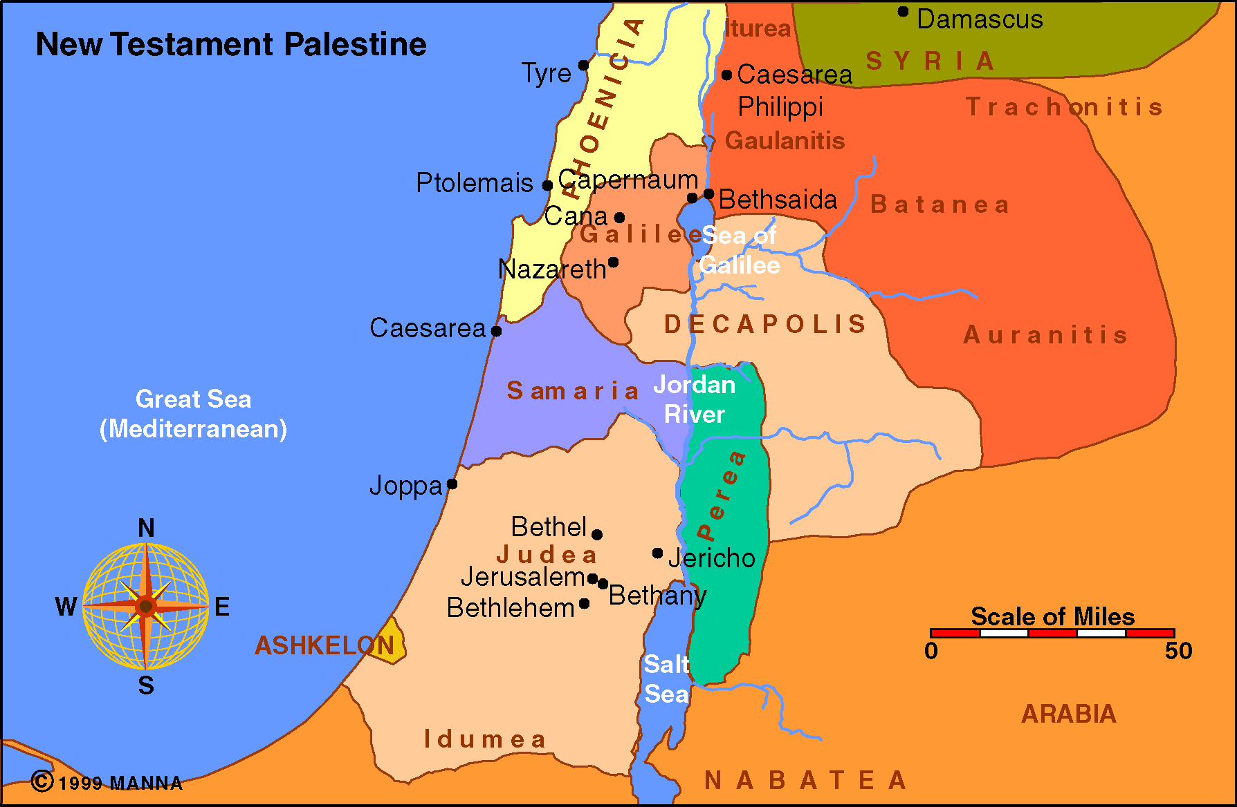
The traditional site of Cana is nine miles north of Nazareth.

Slide 13
John 2:3 And when they ran out of wine, the mother of Jesus said to Him, "They have no wine." ⁴ Jesus said to her, "Woman, what does your concern have to do with Me? My hour has not yet come."

Slide 14
The expression “My hour has not yet come,” is used to describe His death in many other passages (John 7:30; 8:20; 12:23, 27; 13:1; 17:1).

Slide 15
John 2:5 His mother said to the servants, "Whatever He says to you, do it." ⁶ Now there were set there six waterpots of stone, according to the manner of purification of the Jews, containing twenty or thirty gallons apiece. ⁷ Jesus said to them, "Fill the waterpots with water." And they filled them up to the brim. ⁸ And He said to them, "Draw some out now, and take it to the master of the feast." And they took it.

Slide 16
John 2:9 When the master of the feast had tasted the water that was made wine, and did not know where it came from (but the servants who had drawn the water knew), the master of the feast called the bridegroom. ¹⁰ And he said to him, "Every man at the beginning sets out the good wine, and when the guests have well drunk, then the inferior. You have kept the good wine until now!" ¹¹ This beginning of signs Jesus did in Cana of Galilee, and manifested His glory; and His disciples believed in Him.

Slide 17
Did Jesus turn the water into fermented wine?

Slide 18
Plato said, “Wine was always drunk diluted, and to drink it unmixed was looked on as barbarism” (Living Soberly, Righteously And Godly p. 20). Other sources suggest that they would mix six parts water to one part wine. It was not uncommon for people to mix their wine with water or milk.

Slide 19
In the Bible, the word “wine” can mean fermented (Gen. 9:20-26, 19:30-38) or unfermented (Isa. 16:10, 65:8; Joel 2:24). We have to consider the context to decide if the wine is fermented or unfermented.

Slide 20
The reason we know this is because there are many Scriptures that warn against the use of strong drink (Prov. 20:1, 21:17, 23:21, 31-35; 1 Cor. 6:10; Eph. 5:18).

Slide 21
Habakkuk 2:15 “Woe to him who gives drink to his neighbor, Pressing him to your bottle, Even to make him drunk, That you may look on his nakedness!

Slide 22
The first method was to boil the grapes down to a thick mixture called defrutum. They would use this to put on their bread and they would add water to it for a drink.

Slide 23
The second method was to use wool or a similar material to filter the particles including the yeast from the grape juice (Isa. 25:6). This would prevent it from fermenting. Pliny said, “For all the sick, the wine is most useful when its forces have been broken by the strainer.” Pliny teaches us that they used this filtered juice for those who were sick, which means that Paul was most likely recommending unfermented wine for Timothy’s sickness (1 Tim. 5:23).

Slide 24
The third method was to put the wine in a sealed container and put into a pond or a well which would keep it from fermenting. The Zondervan Pictorial Bible Dictionary describes it this way, “If you wish to have grape juice all year, put grape juice in an amphora and seal the cork with pith; sink it in a fish pond. After 30 days, take it out. It will be grape juice for a whole year.”

Slide 25
John 2:12 After this He went down to Capernaum, He, His mother, His brothers, and His disciples; and they did not stay there many days.

Slide 26
He taught in Capernaum’s Synagogue on several occasions (Mk. 1:21; Lk. 4:31-38; Jn. 6:59).
He called five of His disciples here: the four fishermen (Mk. 1:16-21) and the tax collector (Mk. 2:13-14).

Slide 27
He performed many miracles in this area:
Raised Jarius’ daughter from the dead (Mk. 5:22).
Healed the centurion’s servant (Mt. 8:5). This centurion built the synagogue in Capernaum (Lk. 7:1-5).
Healed a paralytic carried by four friends (Mk. 2:1-12).
Healed the fever of Peter’s mother-in-law (Mt. 8:14-15).
Healed the nobleman’s son in Capernaum from Cana (Jn. 4:46-54).
He cast out a demon (Mt. 12:22).
He paid the tax with a coin from a fish’s mouth (Mt. 17:24-27).

Slide 28
Matthew 11:23 "And you, Capernaum, who are exalted to heaven, will be brought down to Hades; for if the mighty works which were done in you had been done in Sodom, it would have remained until this day. ²⁴ "But I say to you that it shall be more tolerable for the land of Sodom in the day of judgment than for you." (also Luke 10:15)

